Slide 1
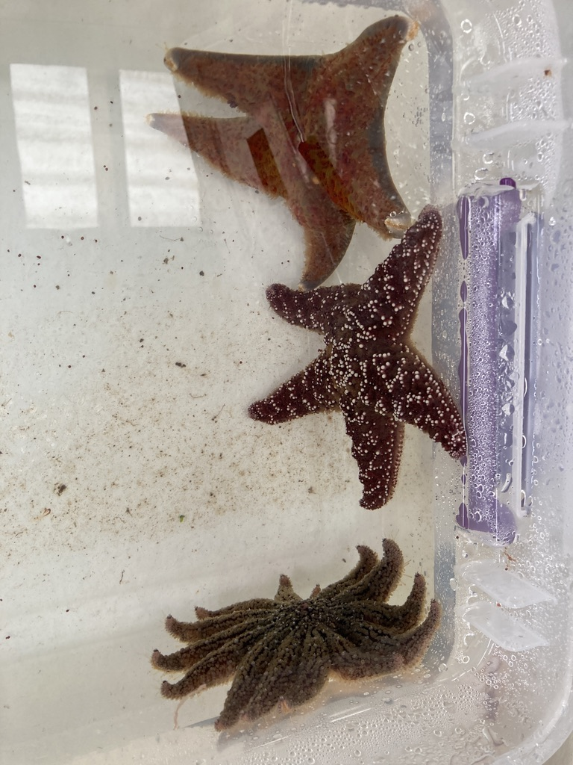

Comparing sea star species with varying susceptibility to sea star wasting disease
Grace Crandall she/her
PhD Student
University of Washington
School of Aquatic and Fishery Sciences
Notes:
PHYSIOLOGICAL ECOLOGY II session 4:45pm

Slide 2
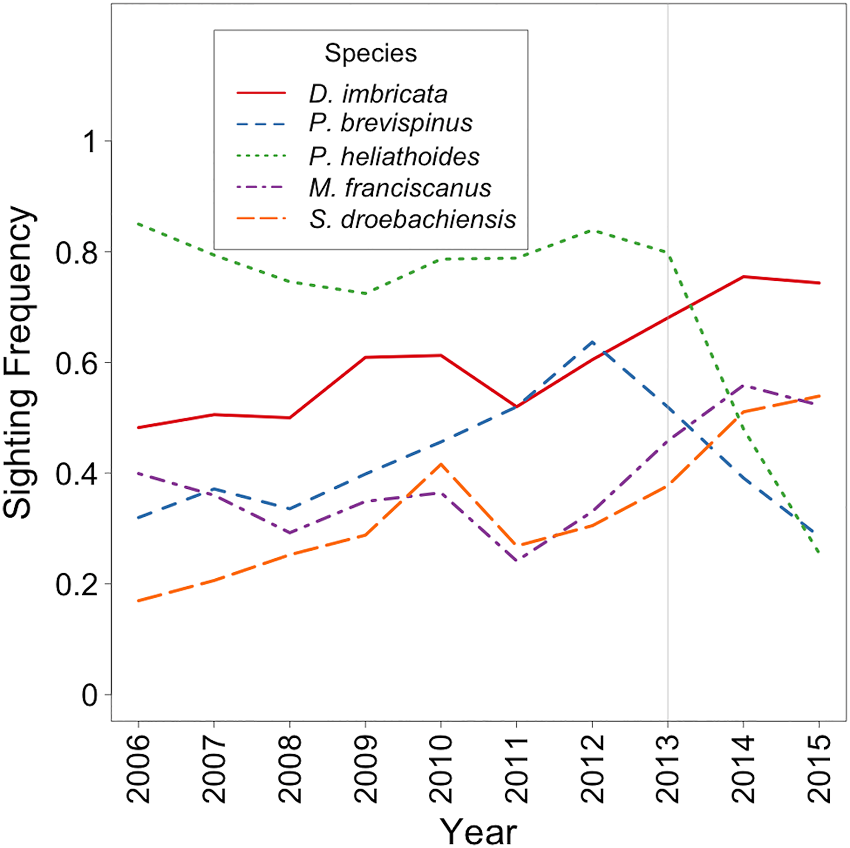
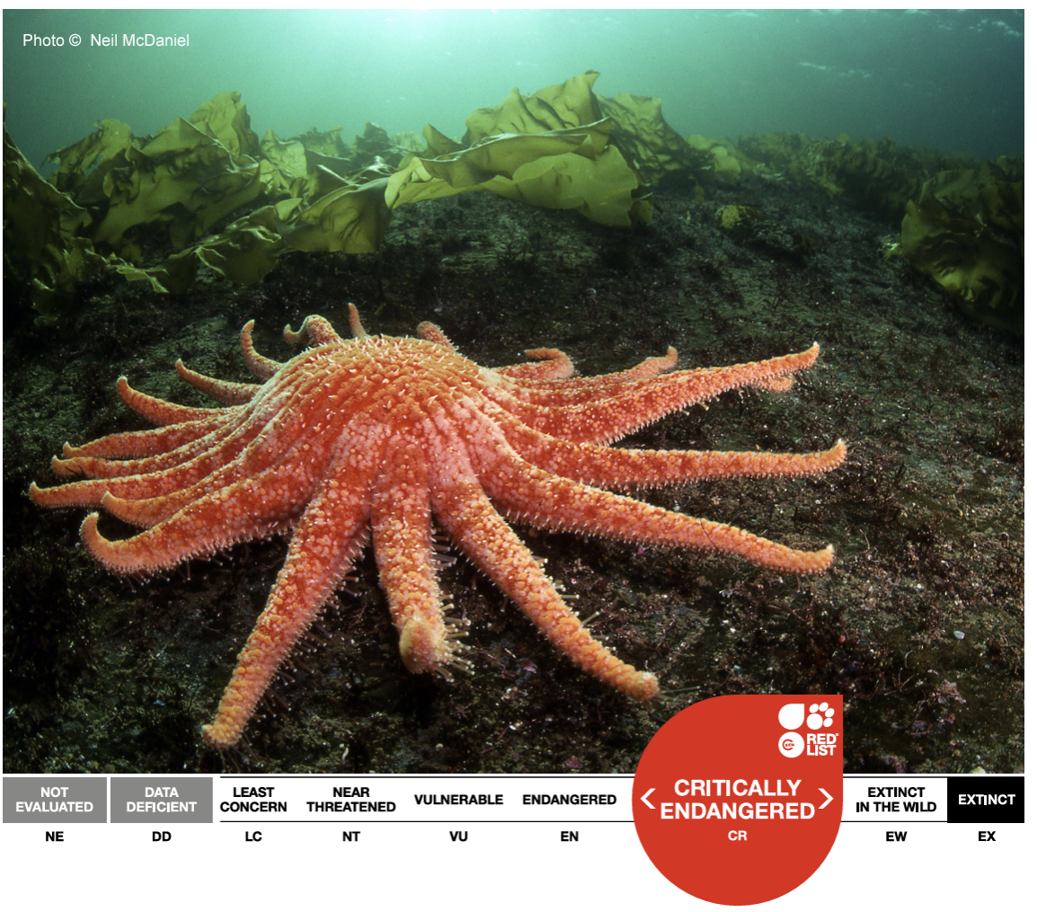
Sea Star Wasting Disease
2013 – present
20+ species; billions of sea stars lost
Some species harder hit than others
Devastating Transboundary Impacts of Sea Star Wasting Disease on Subtidal Asteroids
Montecino-Latorre et al, 2016, PLOS ONE
Notes:
We don’t know why →
Derm pop increasing
pycnos being more susceptible, - critically endangered IUCN
Red and green sea urchins

Slide 3
Does what causes disease in Pycnopodia helianthoides cause disease in other species?
If disease does transfer between species, does it do so evenly, or do some species have some resistance?
What can resistance inform us about recovery efforts for Pycnopodia helianthoides?
NOAA Fisheries
The Nature Conservancy
National Marine Sanctuary Foundation

Slide 4
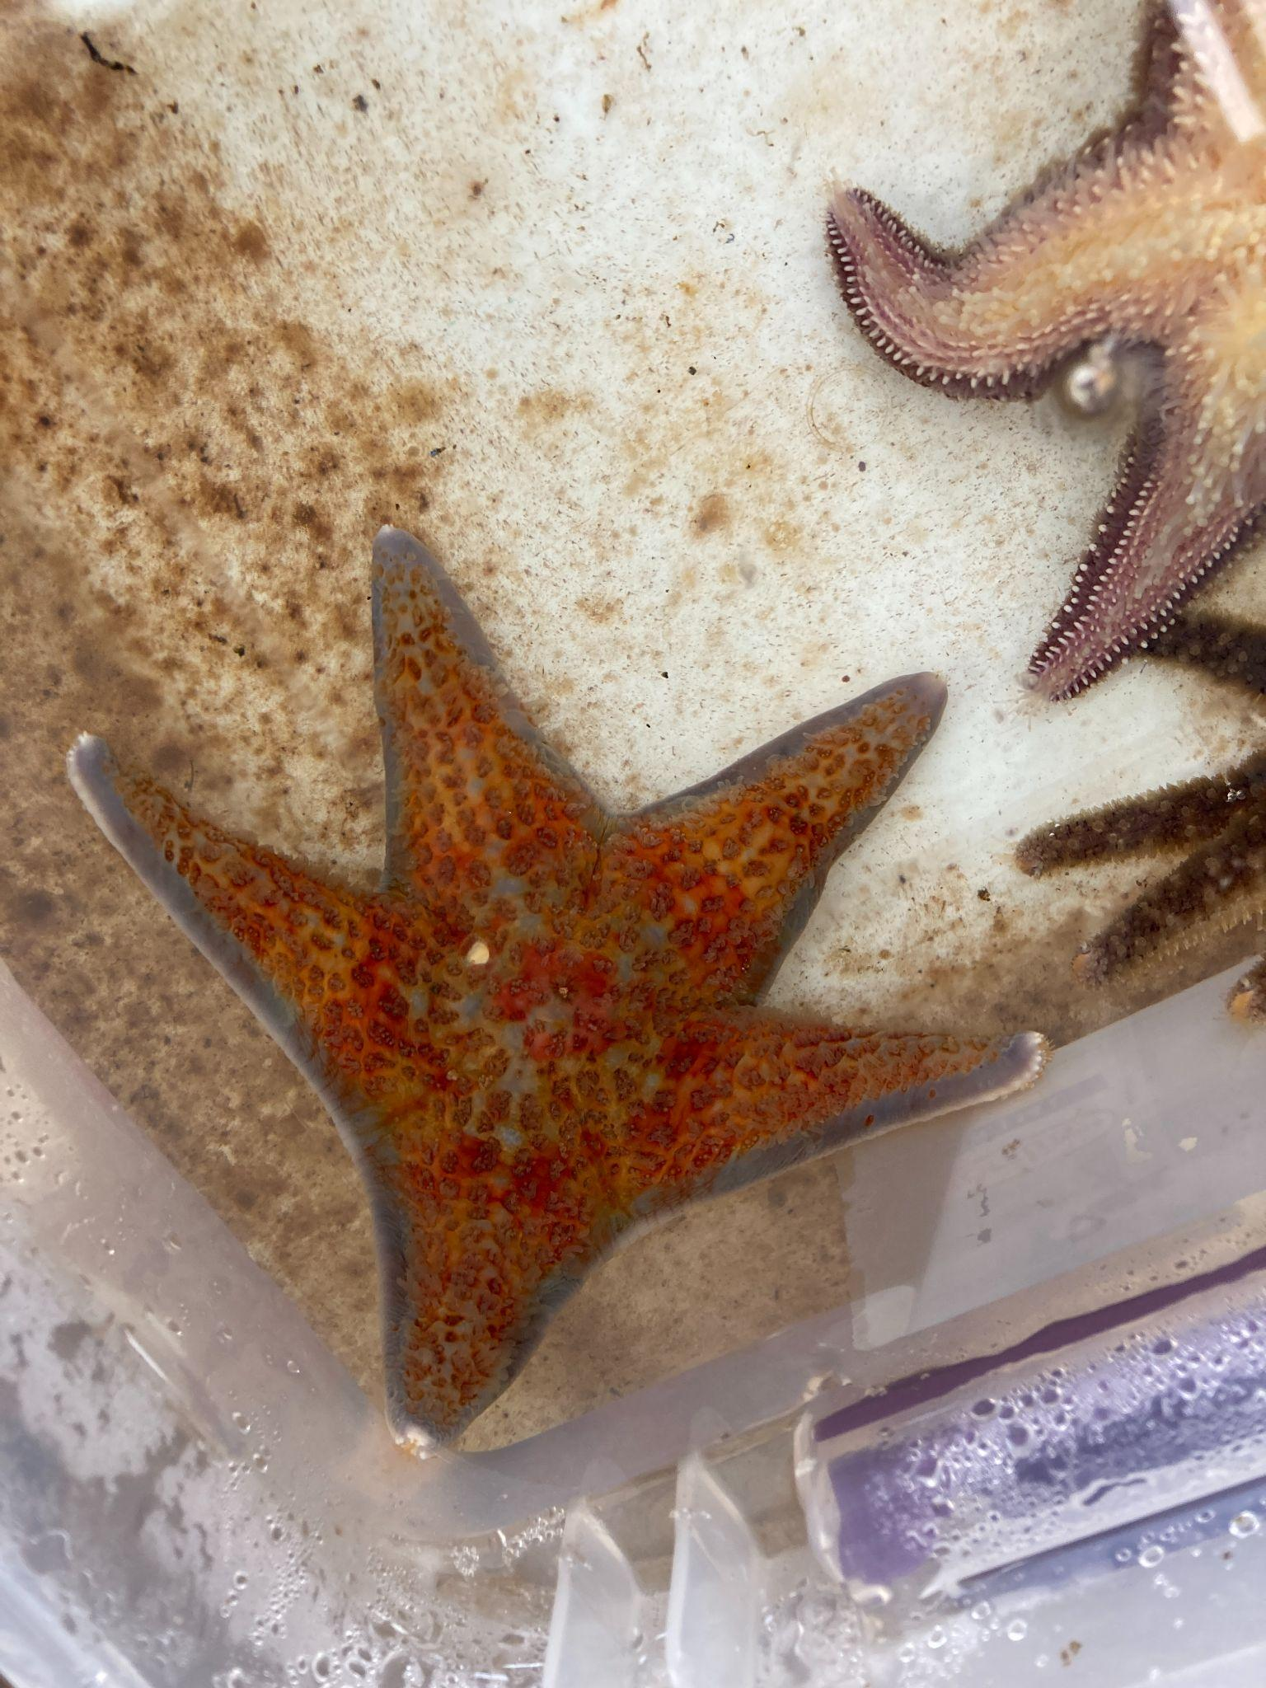
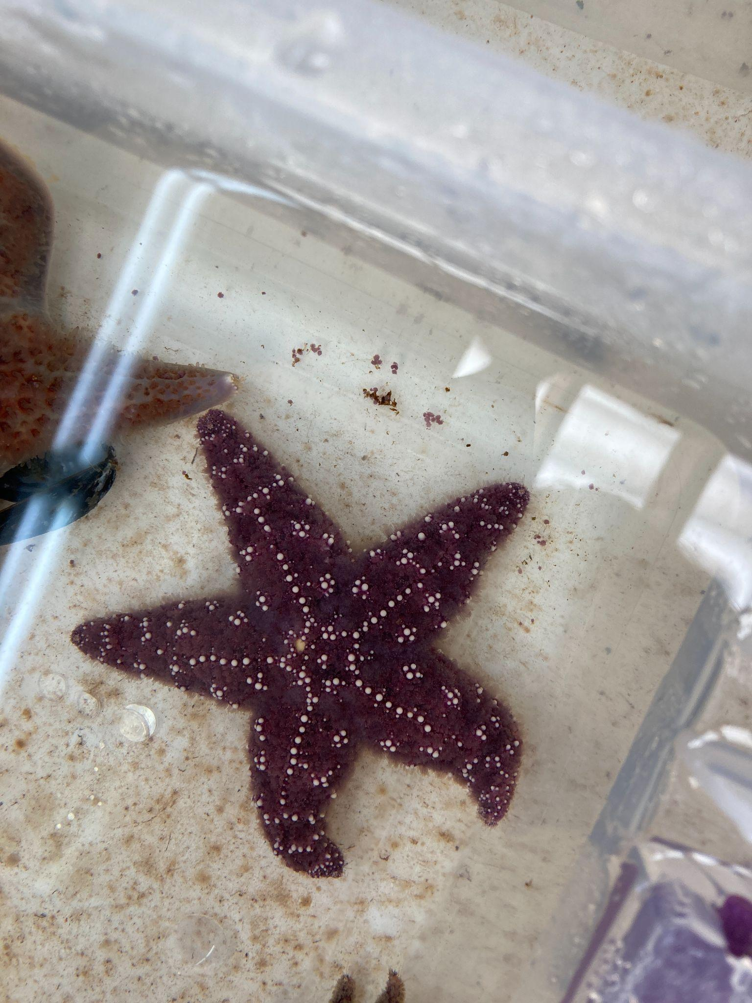
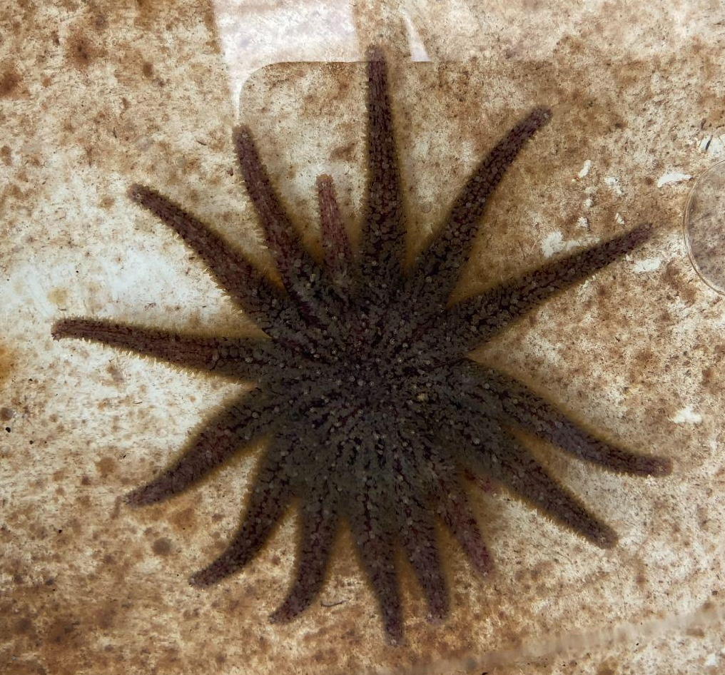
Species Studied
More resistant
Least resistant
Dermasterias imbricata
Leather Star
Pisaster ochraceus
Ochre Star
Pycnopodia helianthoides
Sunflower Star

Slide 5
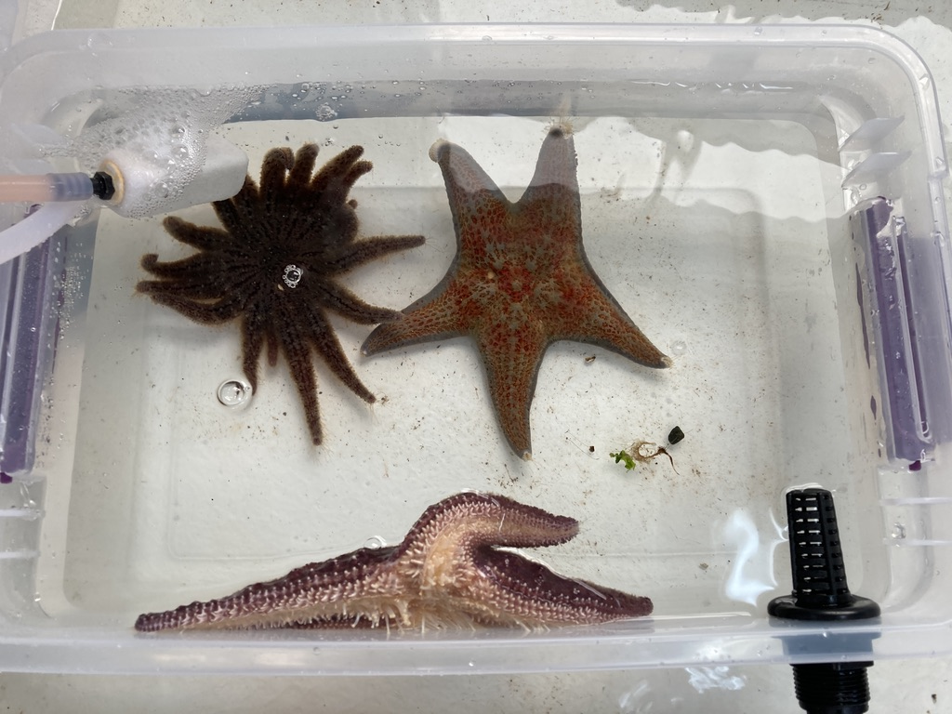
Notes:
isolate and quarantine

Slide 6
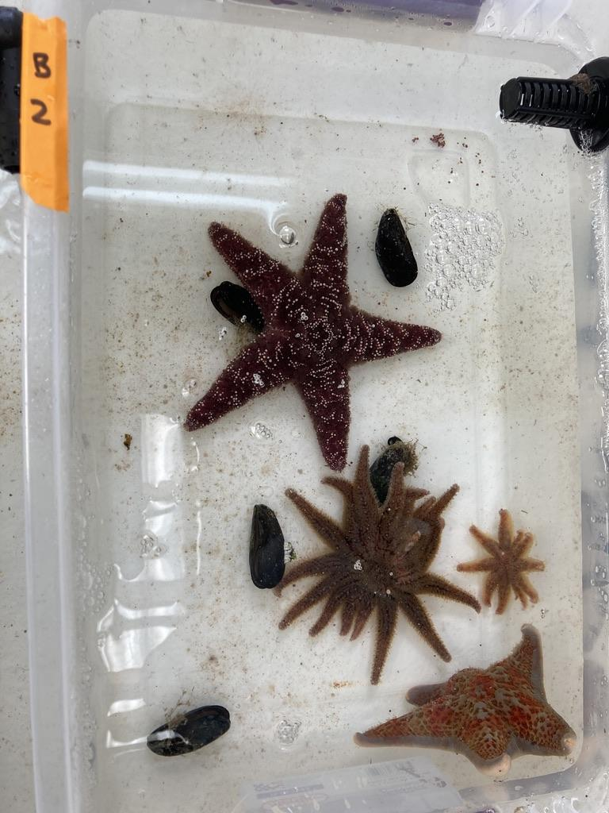
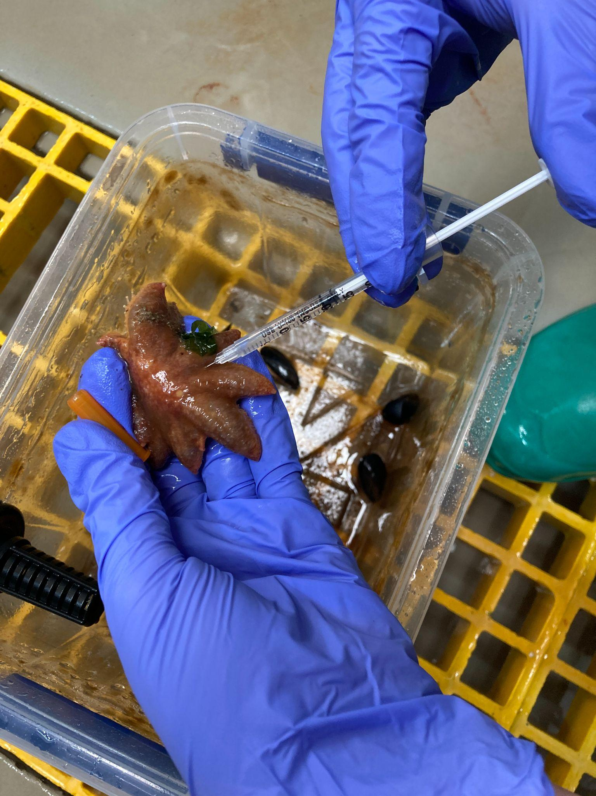
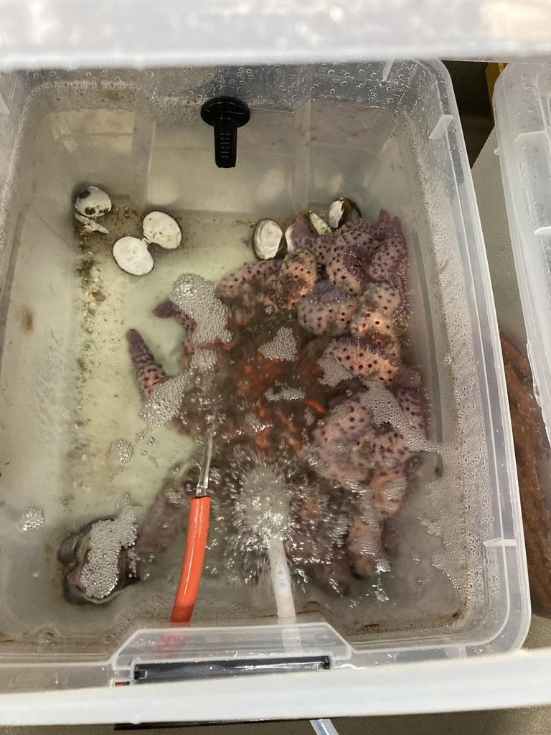
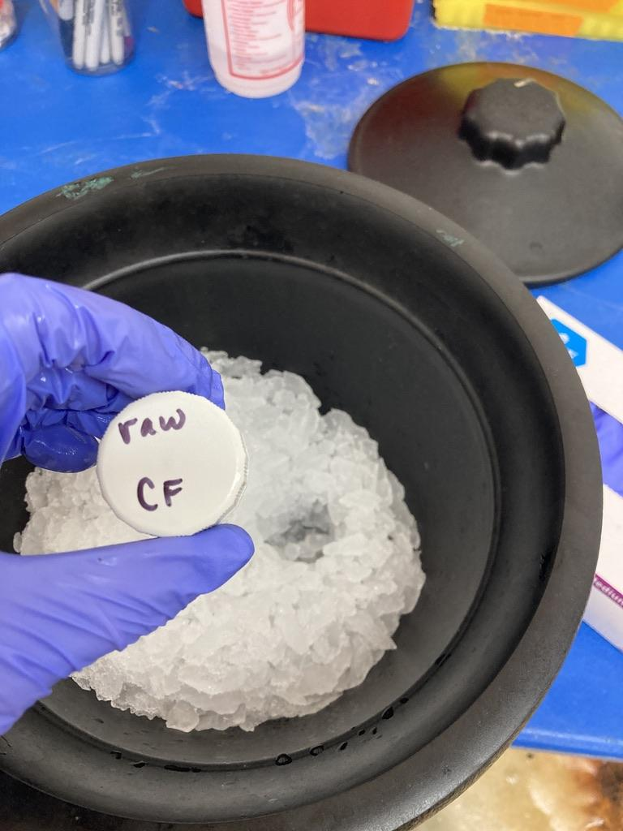
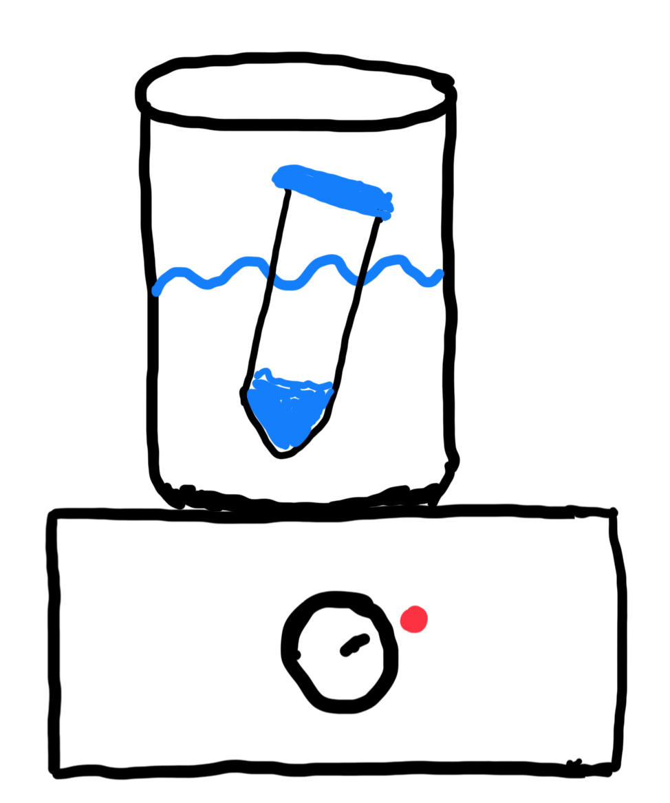
Experimental Design
Focal disease agent
Wasting adult
P. helianthoides
Focal control agent
Notes:
Focal disease agent → define - label on slide and describe as it animates
Focal control agent → define - label on slide and describe as it animates

Slide 7
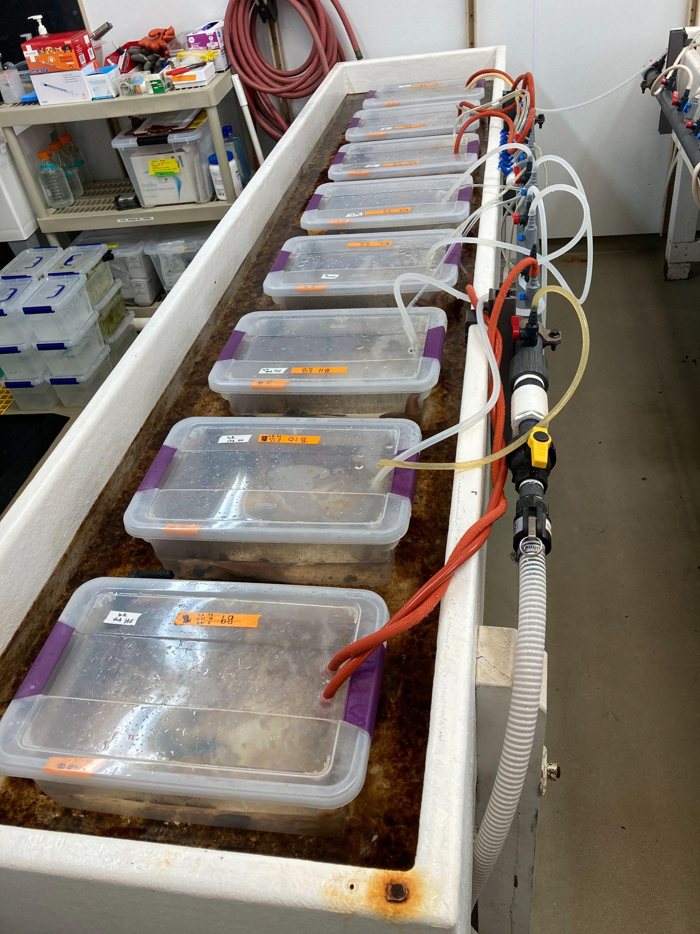
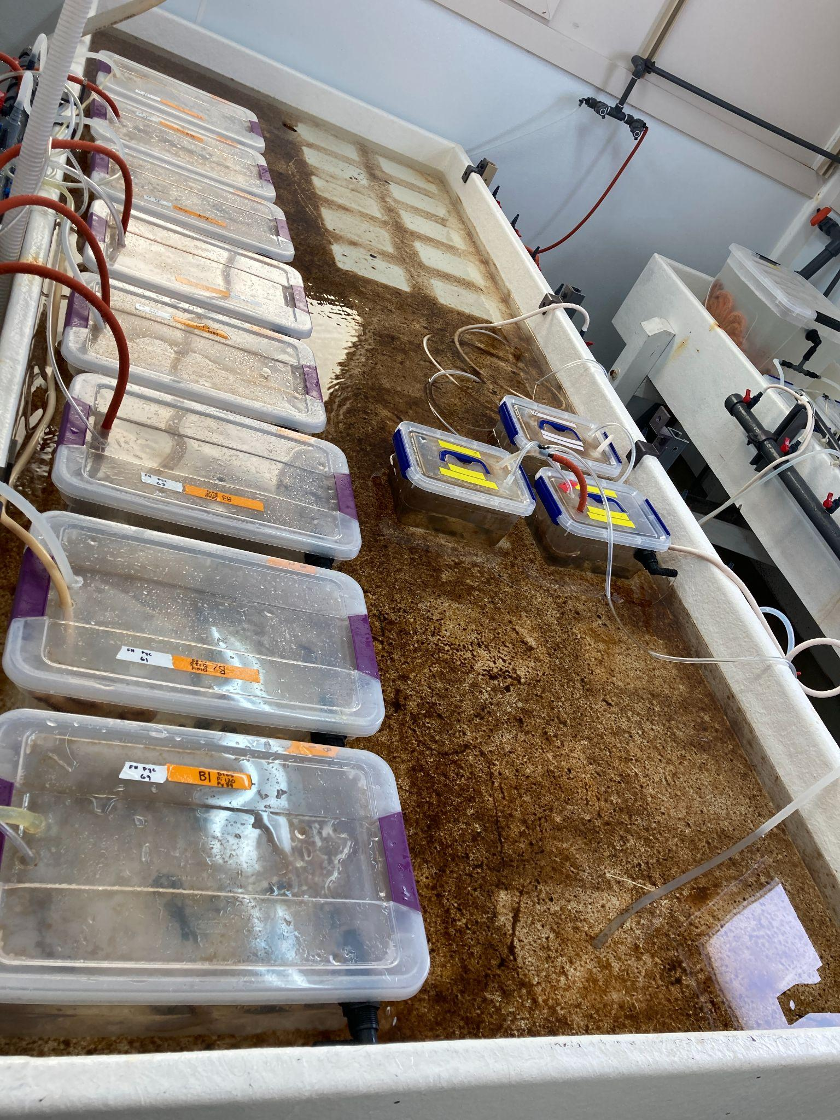
Experimental Design
N=6
N=6
CONTROL
EXPOSED
Notes:
Observed stars 2x/day for the full experiment
All controls remained normal in appearance throughout the duration
- won't show phenotype data

Slide 8
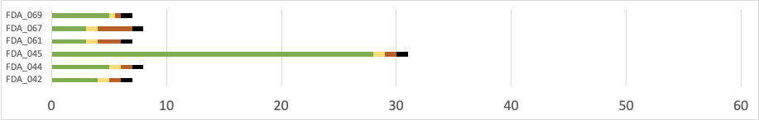
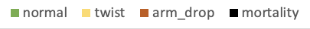
Experiment Day

Slide 9
Experiment Day
Notes:
focal disease agent → we don’t know when window of susceptibility or transmission is
Before mort

Slide 10
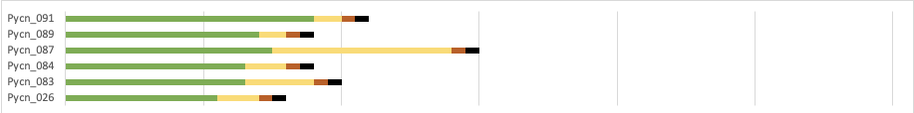
Experiment Day
Notes:
transmit pycno to pycno - some individual variability , but roughly same timeframe within the species

Slide 11
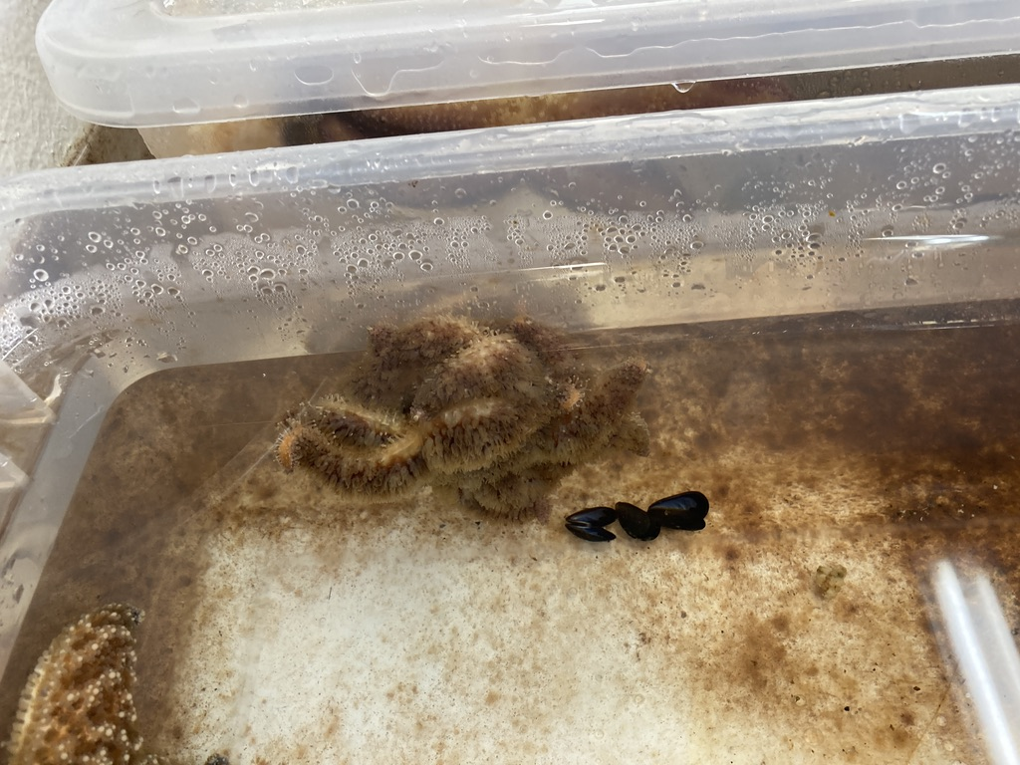
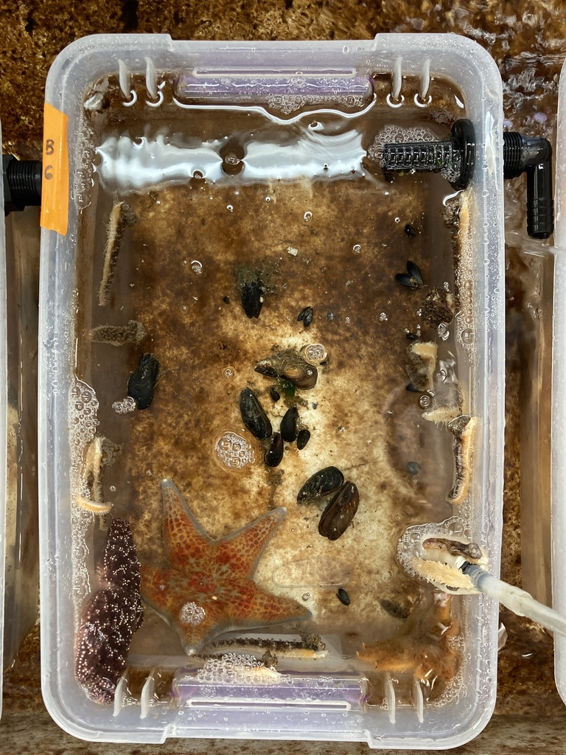
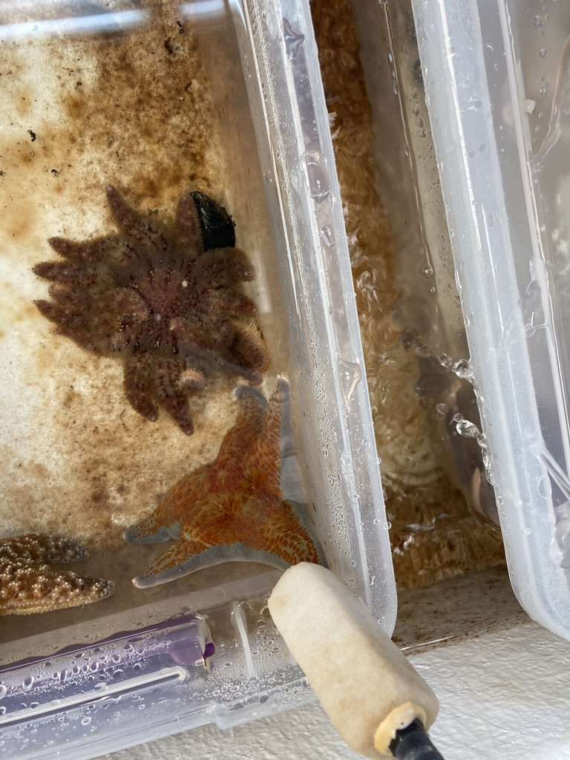
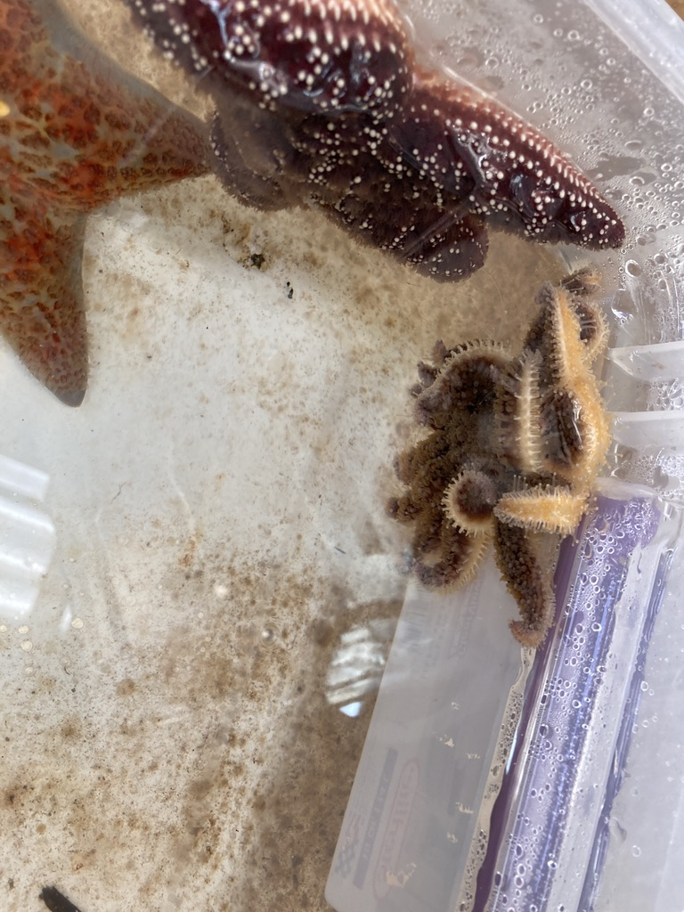
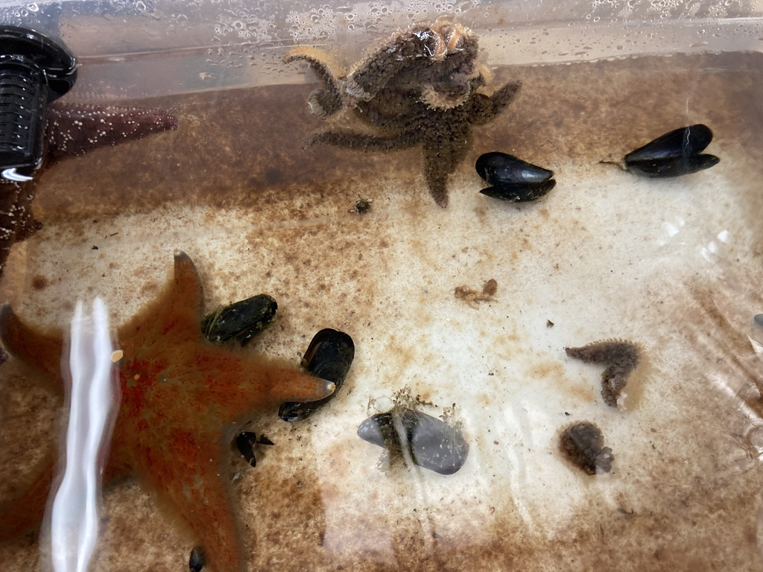
Notes:
PICS OF PYCNOS WASTING

Slide 12
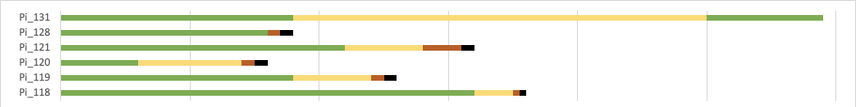
Experiment Day
Notes:
to pisaster - variability in individuals
ONE RECOVERED

Slide 13
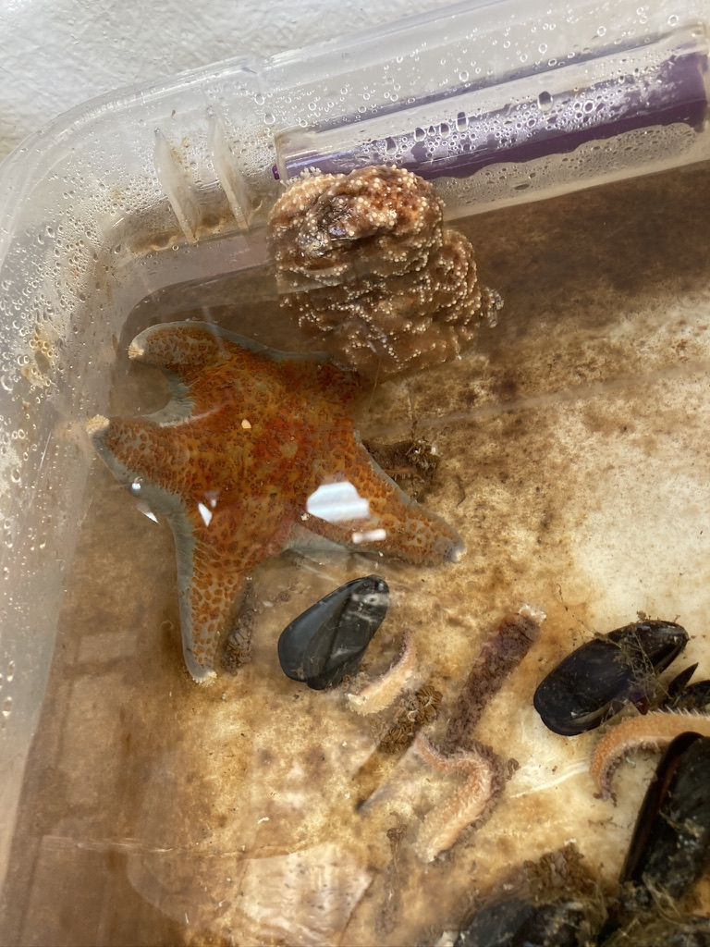
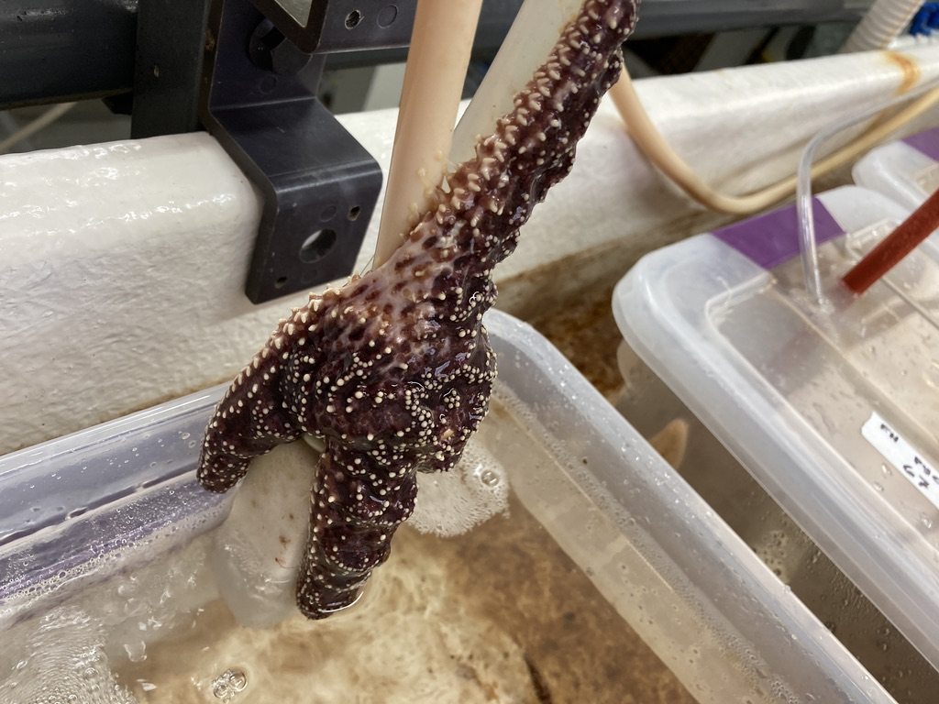
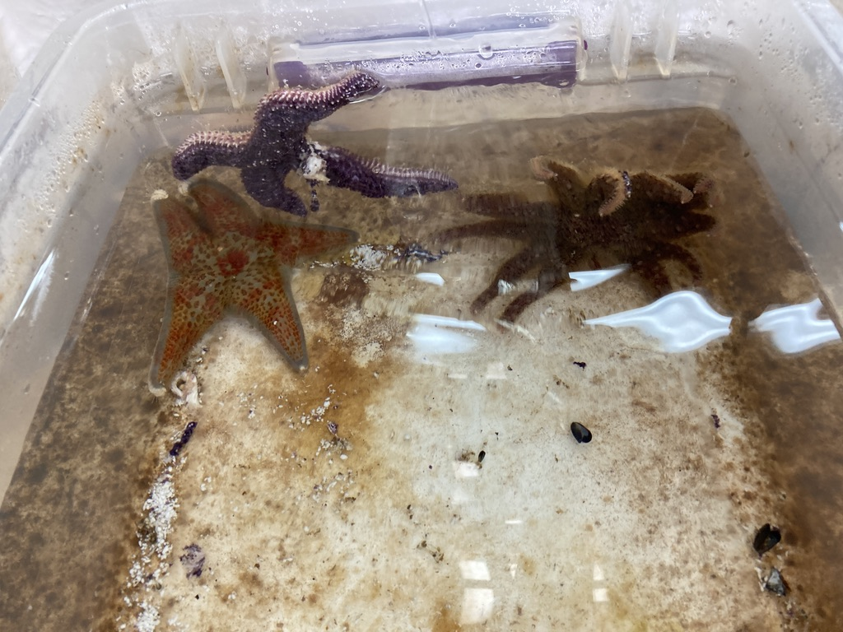
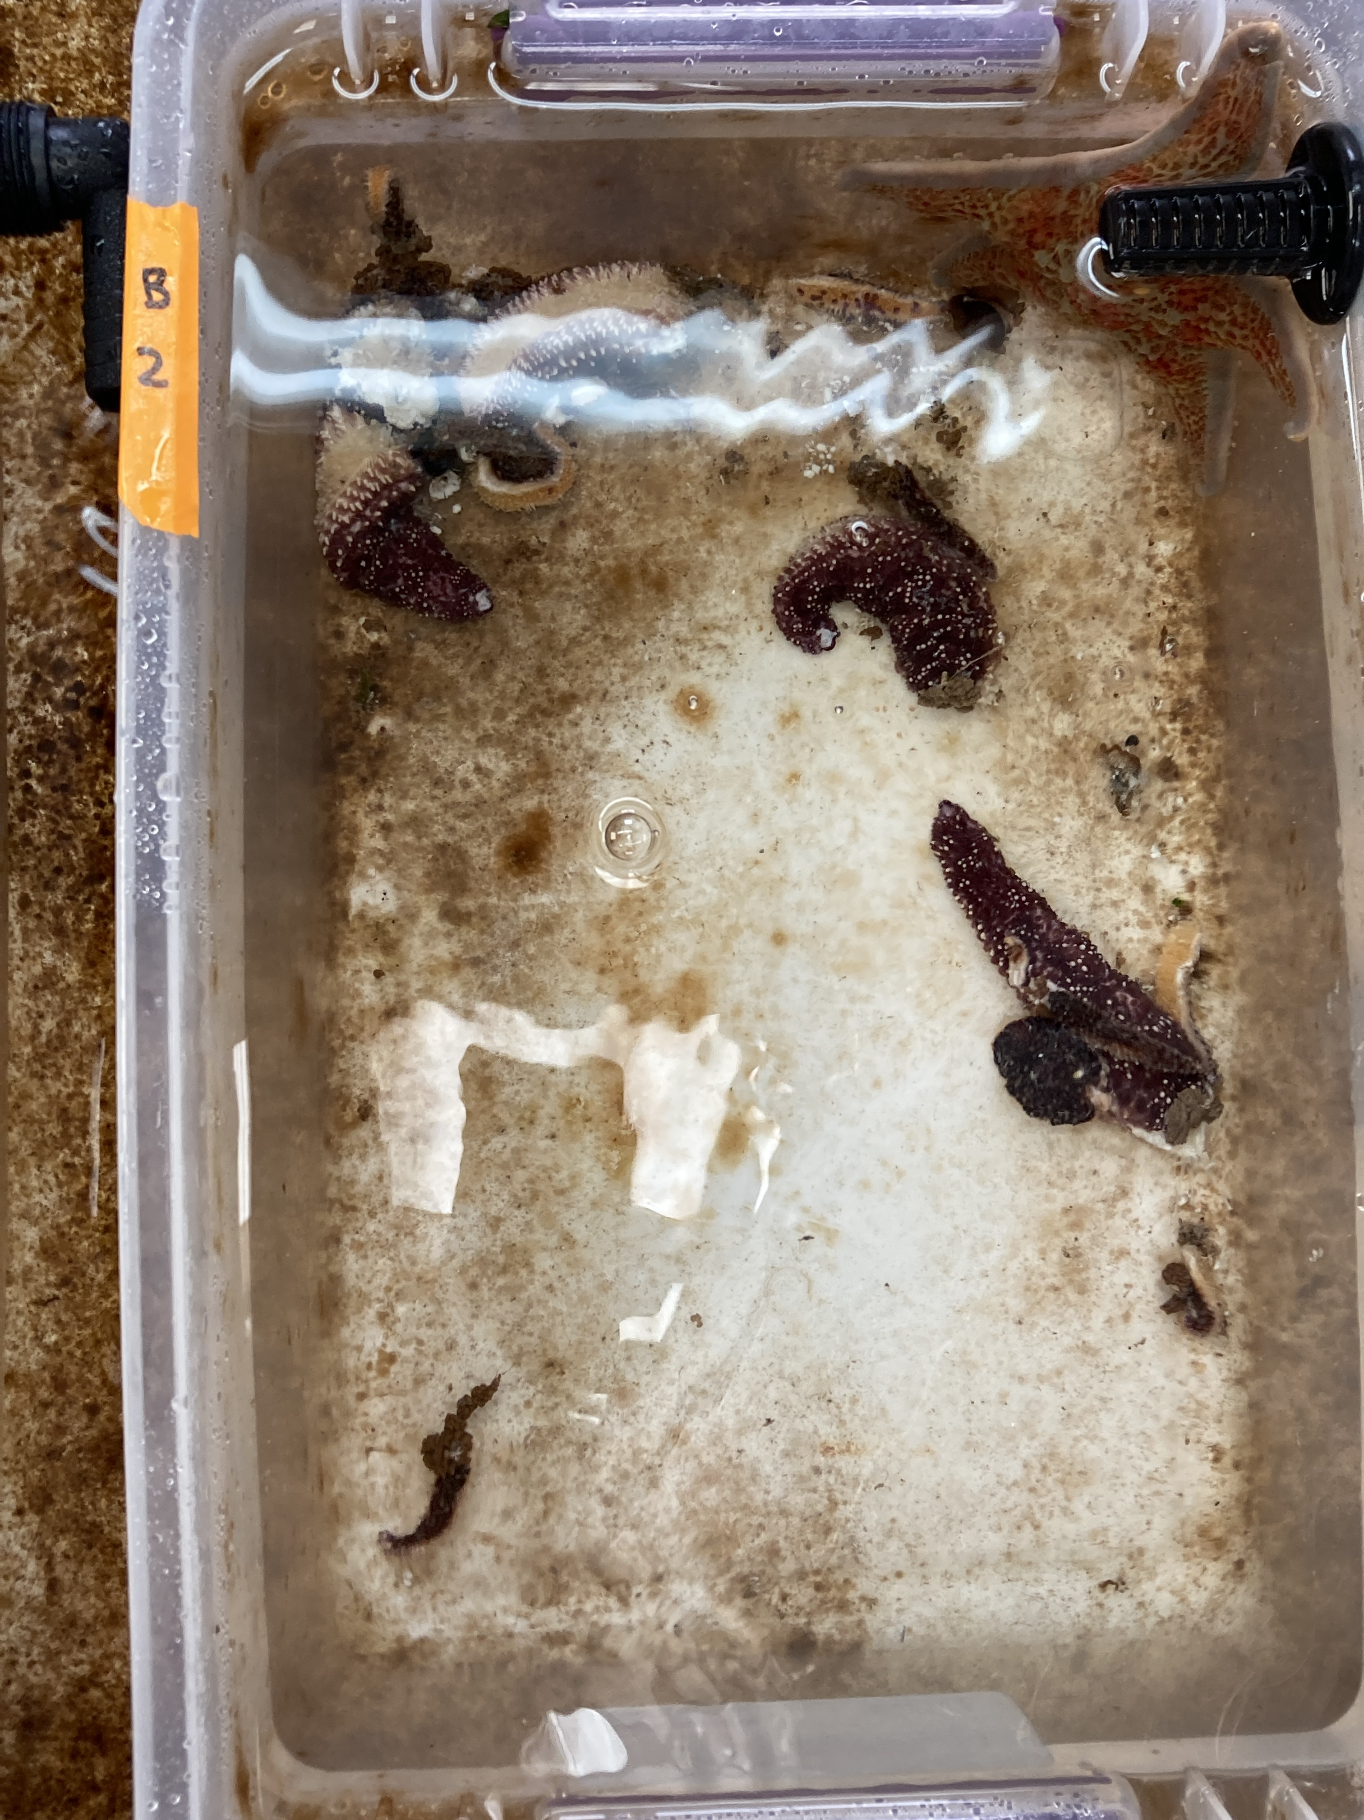
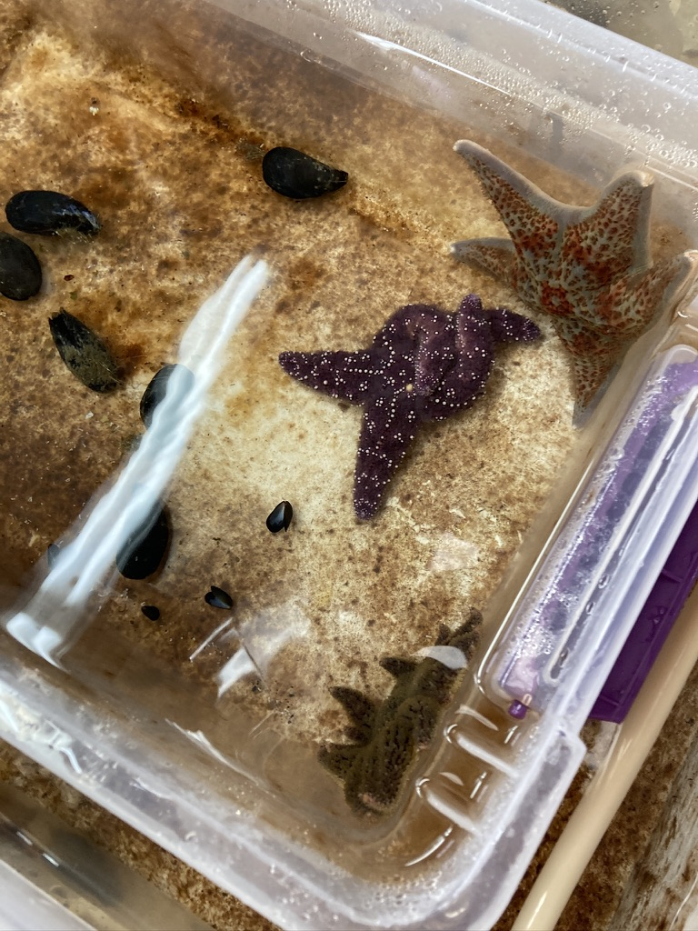
Notes:
Pics of pisasters wasting

Slide 14
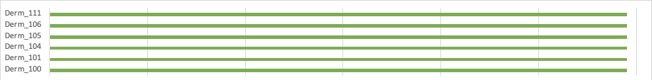
Experiment Day
Notes:
pycno to derm - nothing

Slide 15
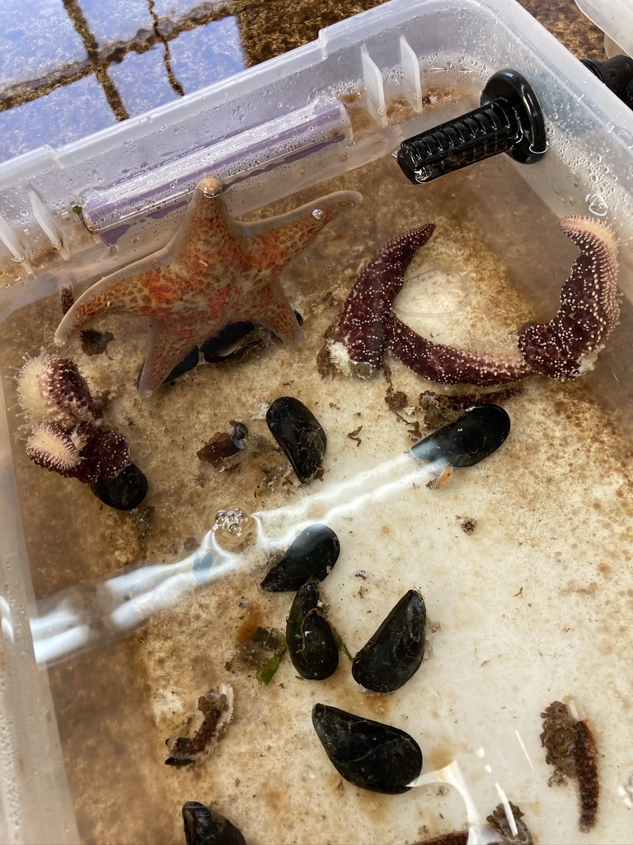
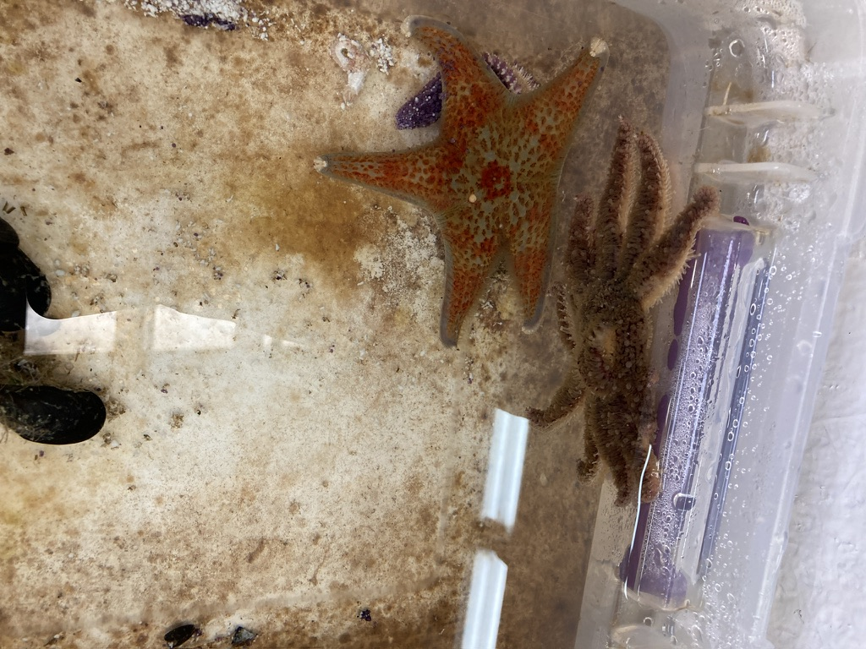
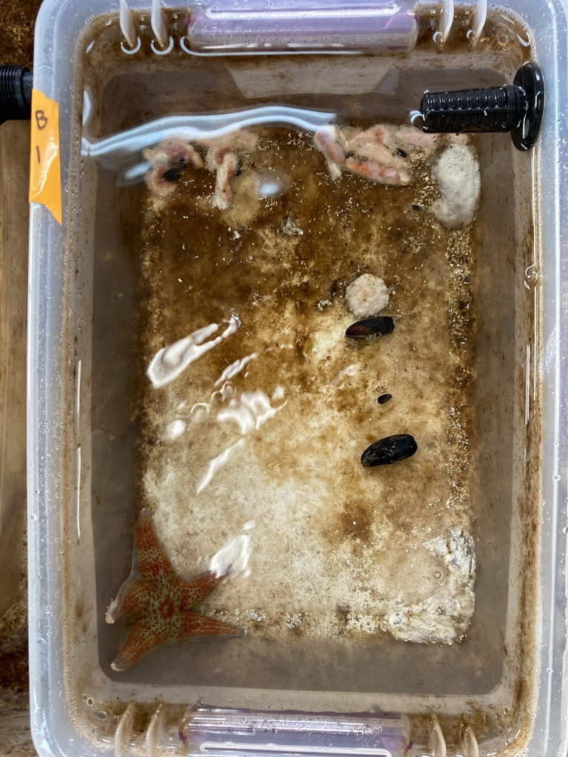
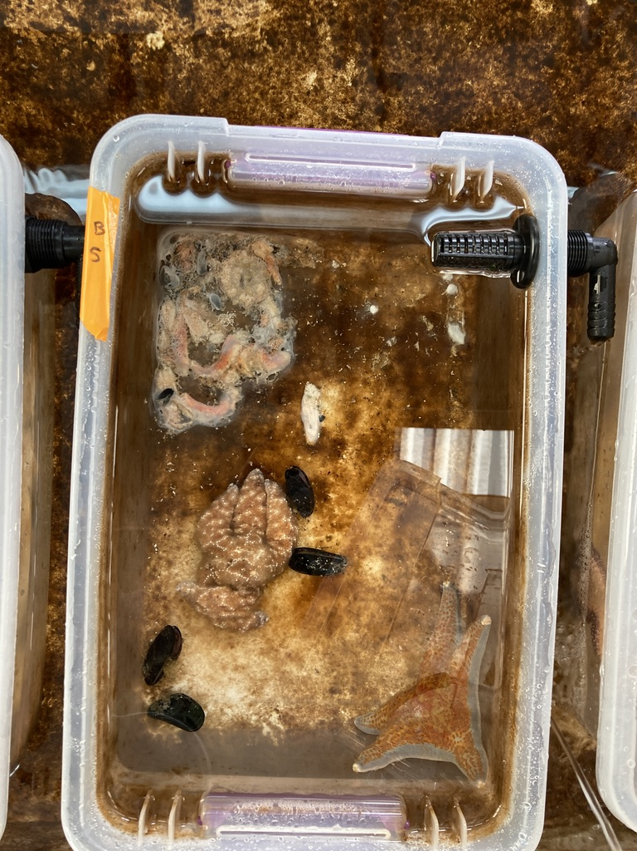
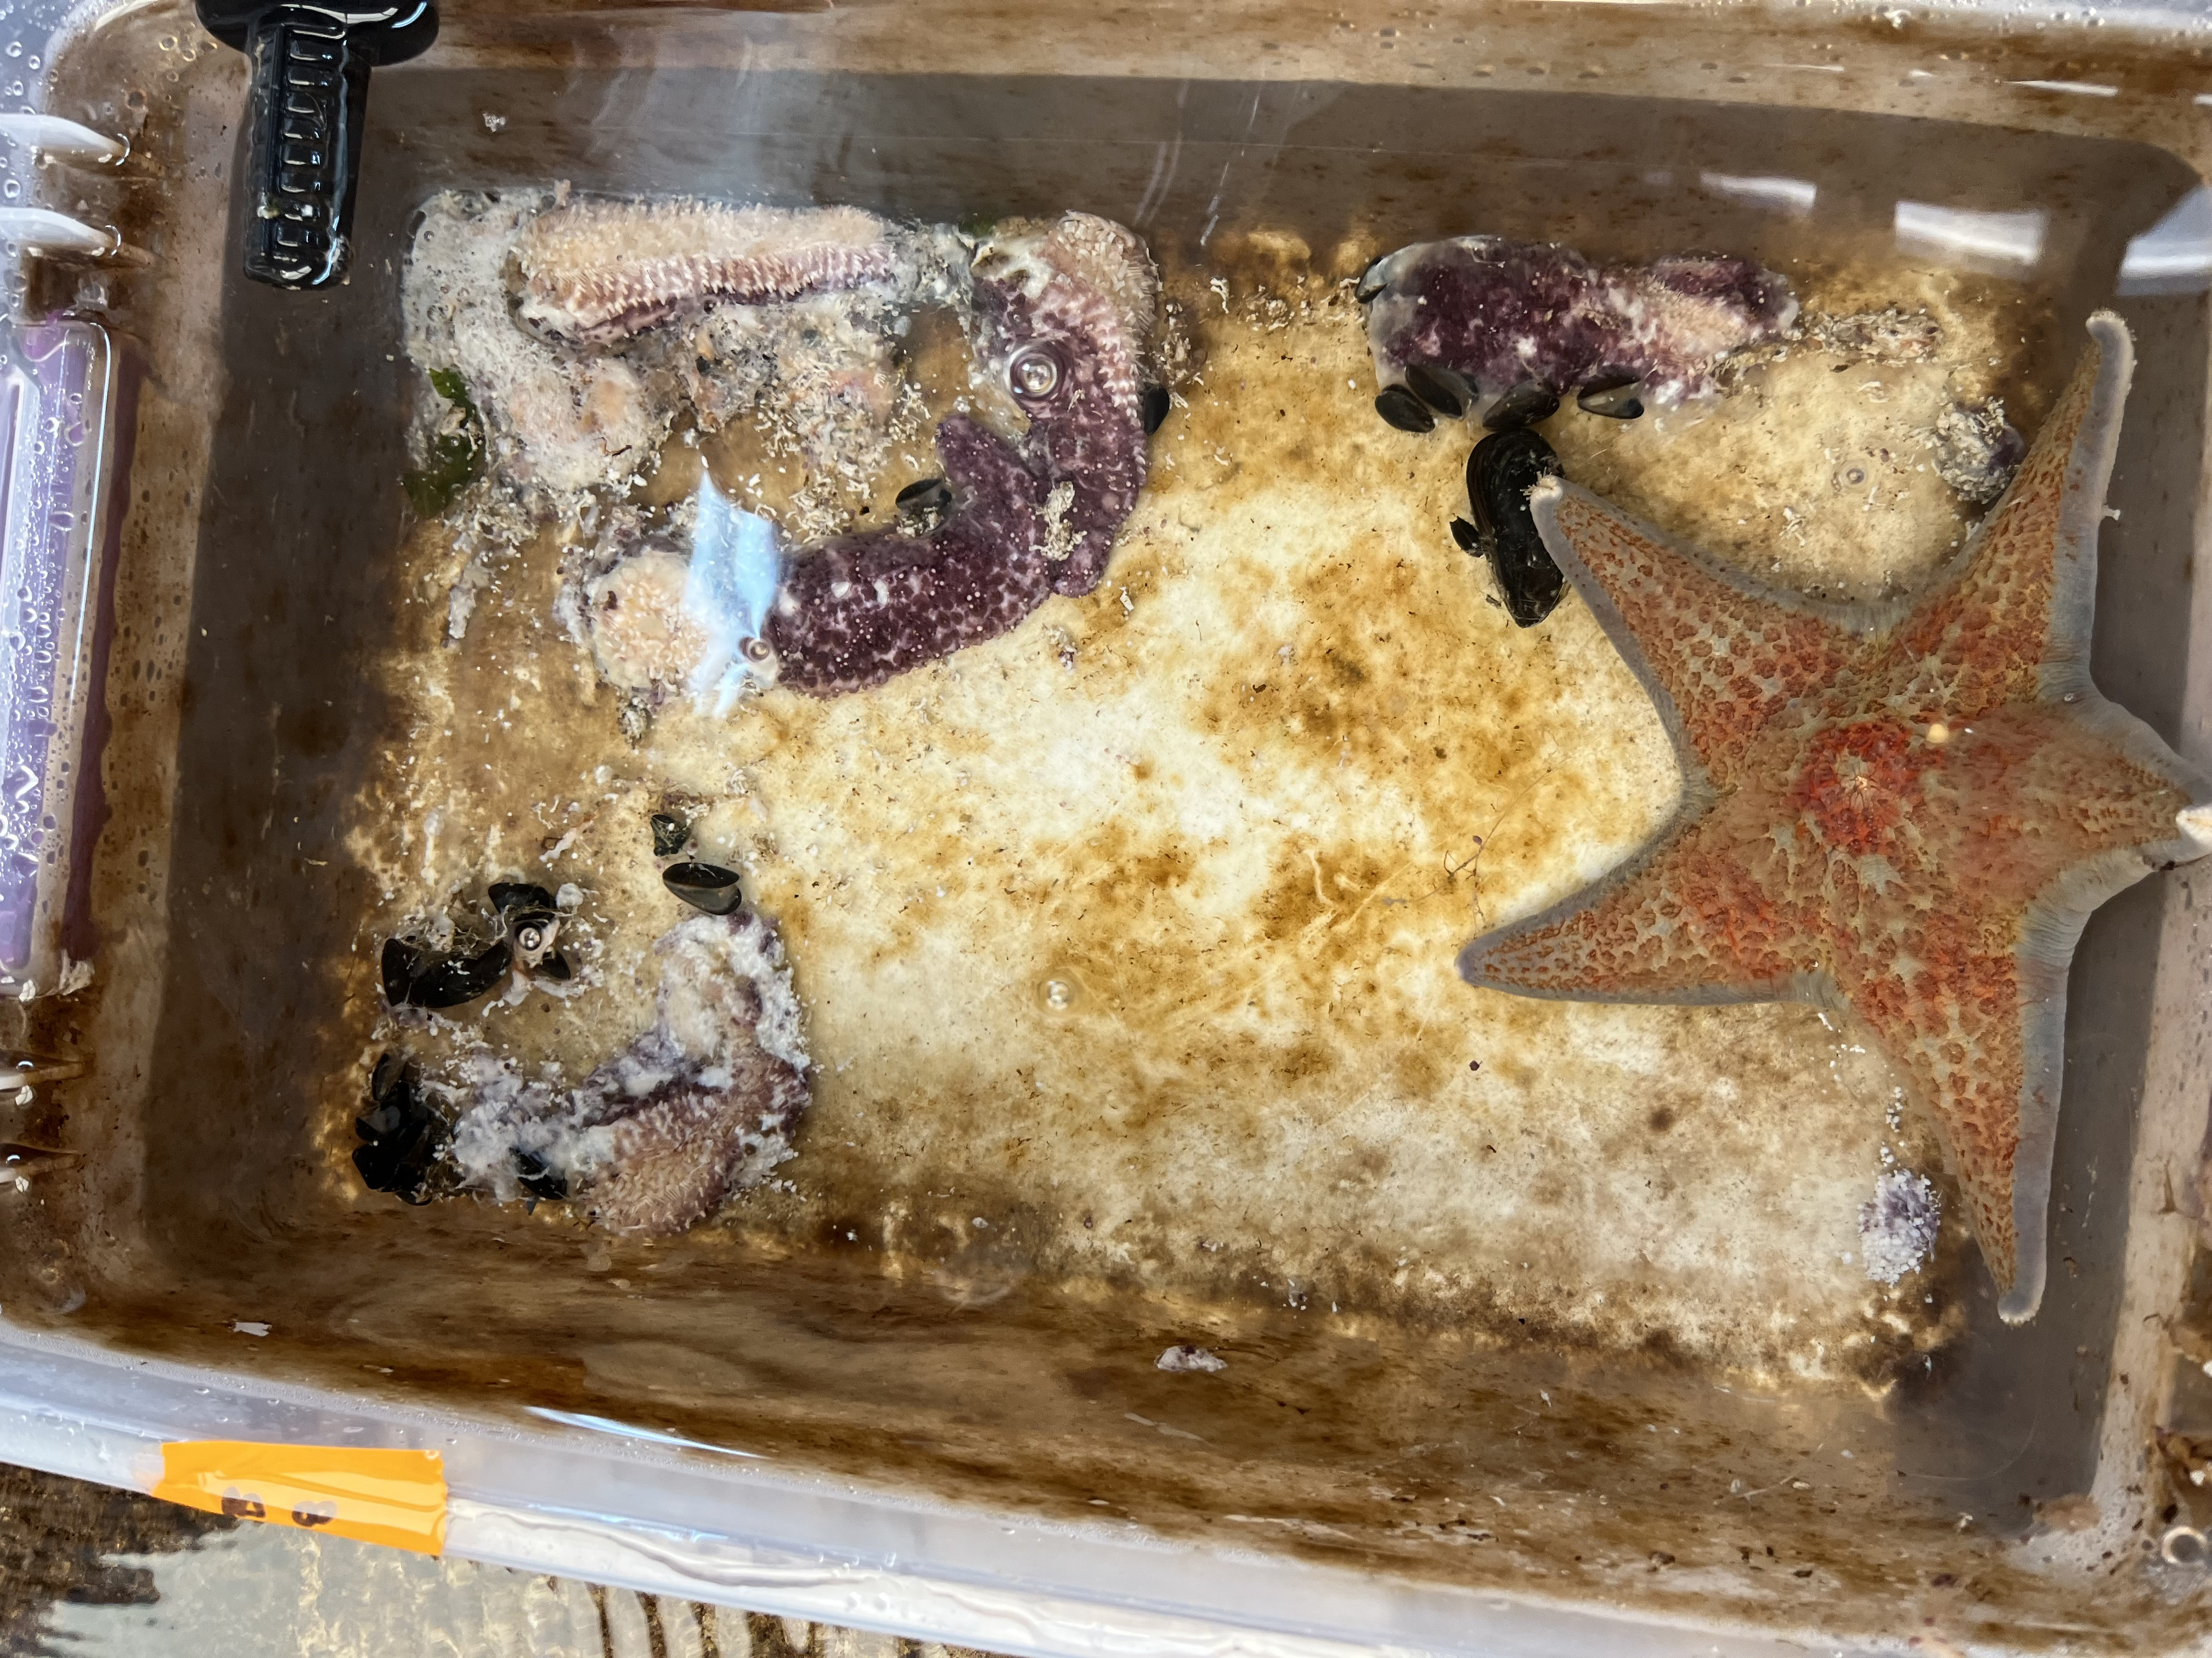
Notes:
PICS of derms in NASTY WATER BEING FINE

Slide 16
RNA-seq
Experiment Day
Notes:
Expeirmental data → it matches pretty well the supposed levels of resistance I talked about at the beginning of the talk
We want to know what’s going on in the stars before disease signs hit, but after exposure was complete
Picked day 12 of the experiment – denoted by red line
Look at gene expression at this time point right here

Slide 17

Coelomocytes
Coelomocytes
Coelomocytes
Notes:
Sampled coelomocytes → cells responsible for innate immune response

Slide 18
Preliminary Comparison
Dermasterias imbricata
Leather Star
Pycnopodia helianthoides
Sunflower Star
More resistant
Least resistant
Notes:
I JUST got the data, so what I’m sharing today is preliminary and the beginnings of a lot of exciting possibilities with this dataset

Slide 19
N=6 RNAseq libraries
N=6 RNAseq libraries
Assemble transcriptome de novo
Assemble transcriptome de novo
Annotate with BLAST and uniport/swissprot
Annotate with BLAST and uniport/swissprot
Annotate with Gene Ontology (GO) and GO Slim Terms
Annotate with Gene Ontology (GO) and GO Slim Terms

Slide 20
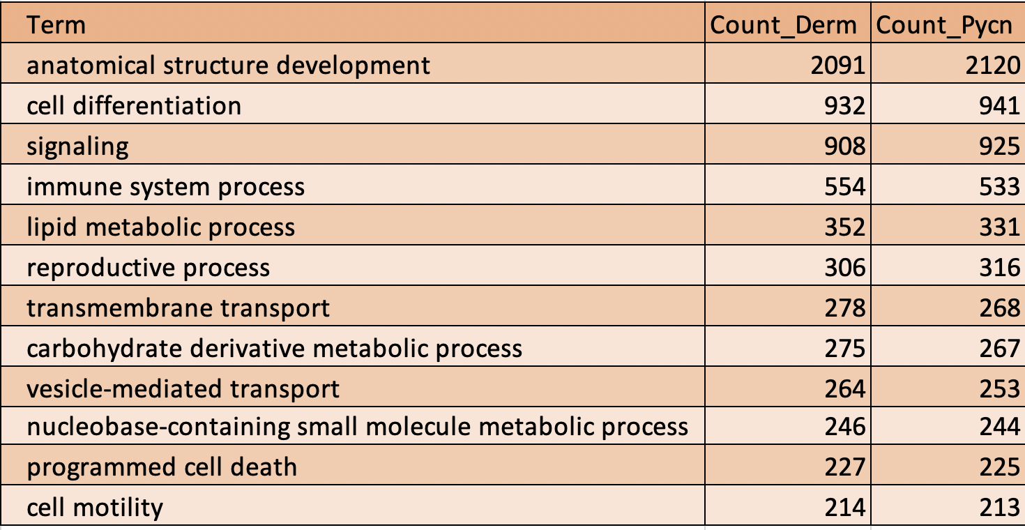
Abundant Biological Processes

Slide 21
Abundant Biological Processes
Notes:
These are abundant biological process
the high level categories of processes in the transcriptome
→ very interested in the immune system process
Lots of classifications under the immune response
High level small differences → lots of cool things
In the future will look more at individuals

Slide 22
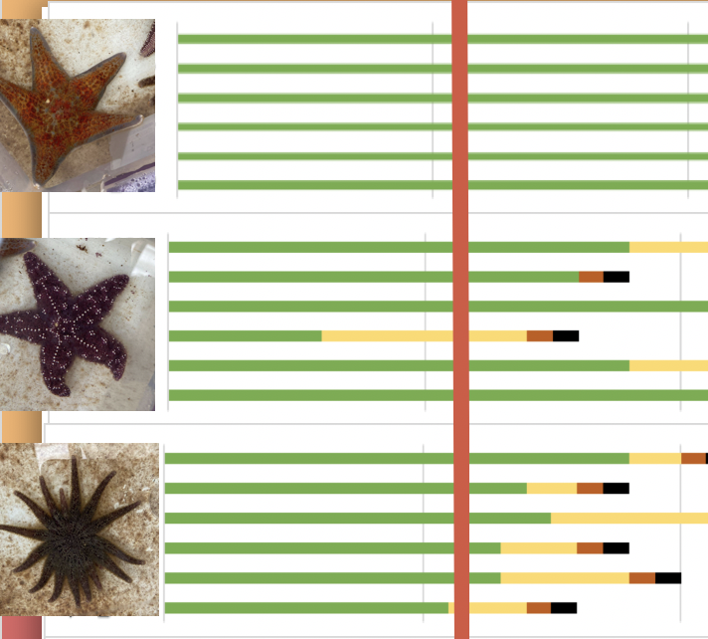
Exciting Directions
Find orthologous immune pathways across species
Examine correlation of expression profile to phenotype
Look at gene family expansion across species
Identify divergent genes, unique domains, unique genes
Characterize non-host sequences and expression levels
Characterize long non-coding RNAs and expression levels
Identify genetic variation (SNPs) that could relate to phenotype
Do we see any tank specific expression patterns
Characterize diversity of expression patterns within and across species
Any other ideas? Come talk to me!
Notes:
Orthologous → genes in different species that originated from same ancestor
Gene family expansion → process – one species may have a bunch more genes expressed related to that process than another species
Roberts lab – does a lot of long noncoding RNA work – I haven’t done it, but that’s a possibility with this dataset and to characterize

Slide 23


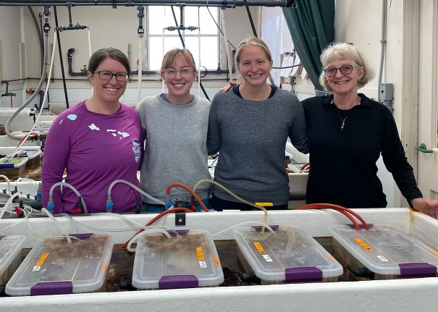




Acknowledgements
Notes:
USGS Marrowstone Crew
TNC - funding
Hakai
Steven Roberts Lab
WDFW dive team

Slide 24

Thank you!
My LinkTree:
Email: graceac9@uw.edu Website: grace-ac.github.io

